Slide 1
Ticket Booking Assignment
19126354 周裕清 YuqingZhou
19126332 邢桐 TongXing
19126306 罗钰琛 YuchenLuo
19126309 马洁 JieMa

Slide 2
Everyone's contribution
Yuqing Zhou: API document + data design
Tong Xing: Interface + API Gateway
Yuchen Luo: Message broker: RabbitMQ
Jie Ma: Testing

Slide 3
Jie Ma

Slide 4
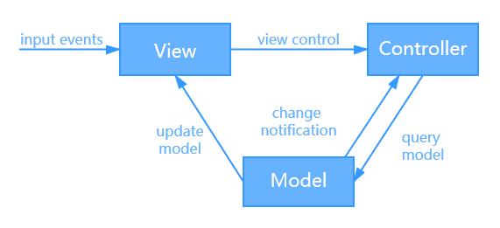
Architecture
The project uses MVC architecture.It consists of three parts：
Model: Responsible for storing the central data of the system.
View: Display information to the user.
Controller: Processing information input by the users.

Slide 5
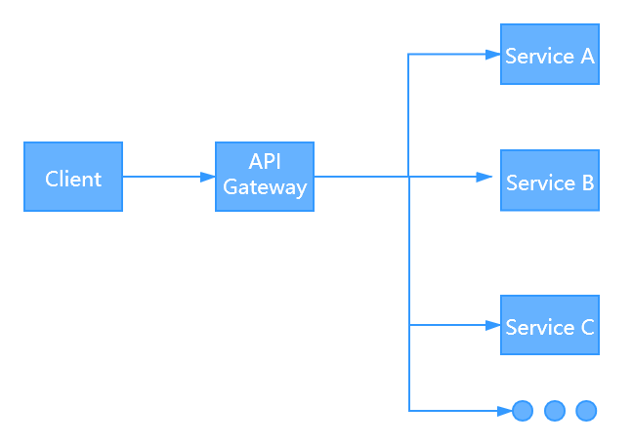
Design Pattern
Gateway Routing pattern：
This pattern routes requests to multiple services using a single endpoint.

Slide 6
Yuqing Zhou

Slide 7
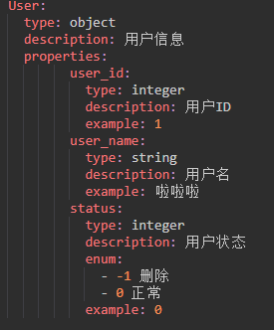
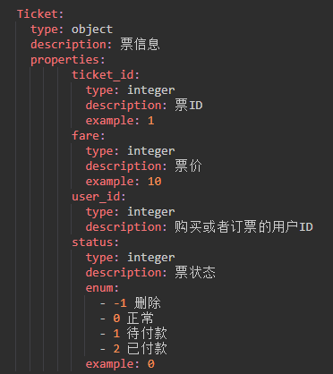
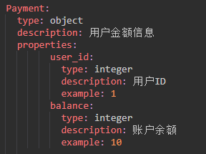
Data Schema

Slide 8
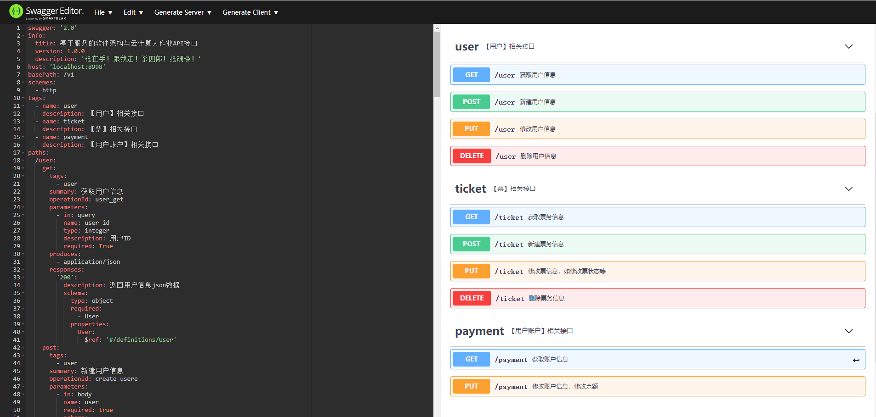
API Document

Slide 9
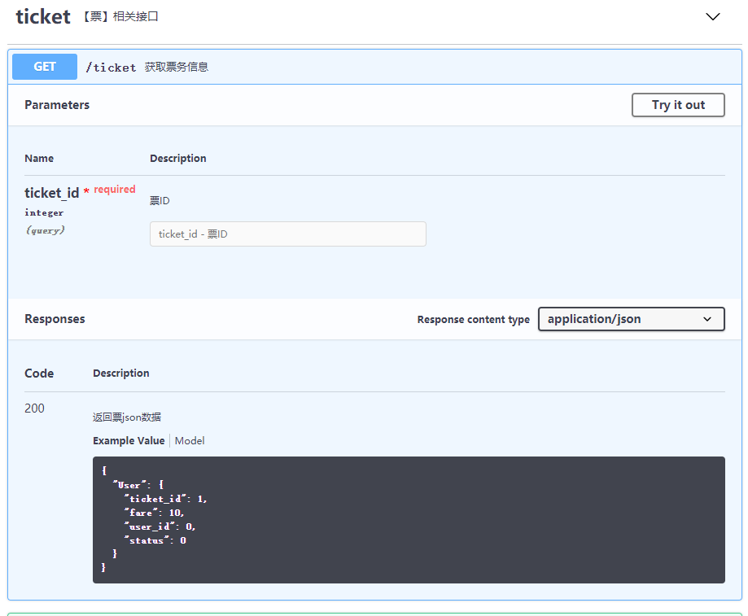
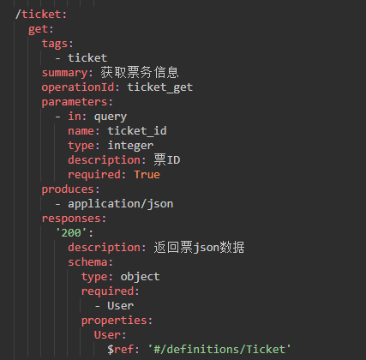
API Example

Slide 10
Tong Xing

Slide 11
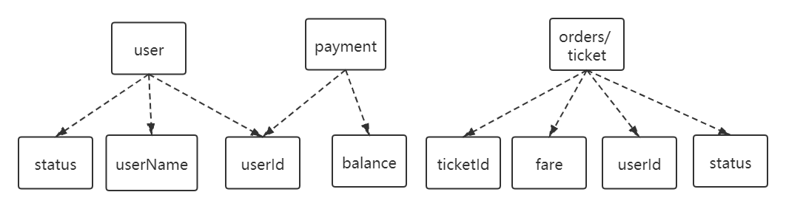
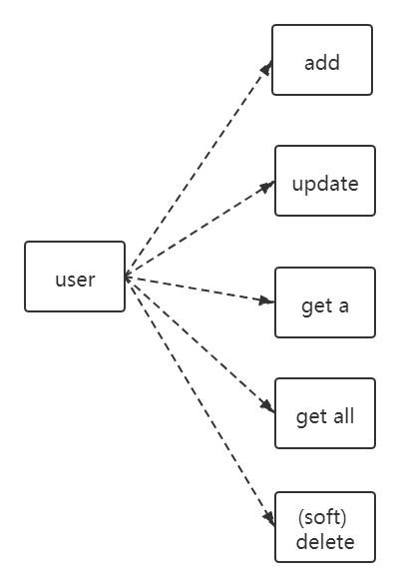
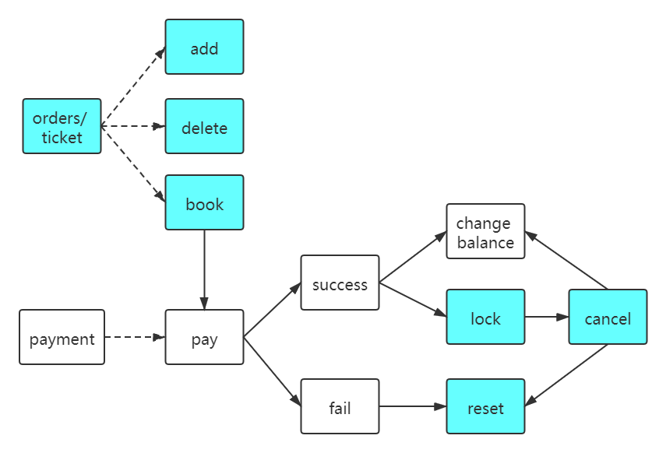
Interface

Slide 12
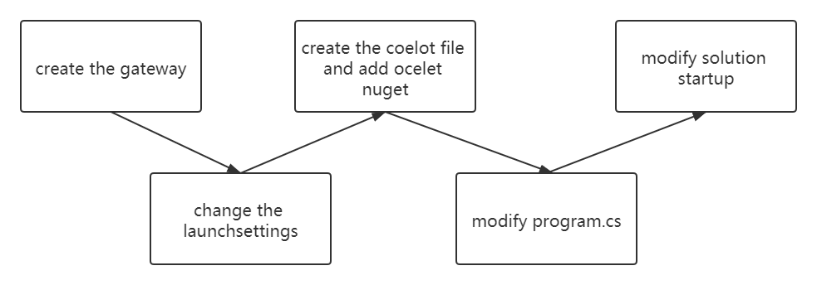
API Gateway

Slide 13
Yuchen Luo

Slide 14
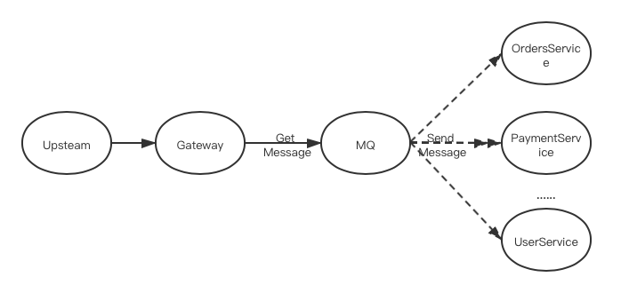
Middleware - RabbitMQ
MQ is a cross-process communication mechanism used to deliver messages upstream and downstream.

Slide 15
Middleware - RabbitMQ
Reasons to use RabbitMQ：
a) Asynchronous: Reduce the waiting time.
b) Peak-cutting and valley-filling: Reduce the sudden flow shocks.
c) Decoupling: After each module is finished, it is enough to send the message out, and the downstream module is to listen.

Slide 16
Jie Ma

Slide 17
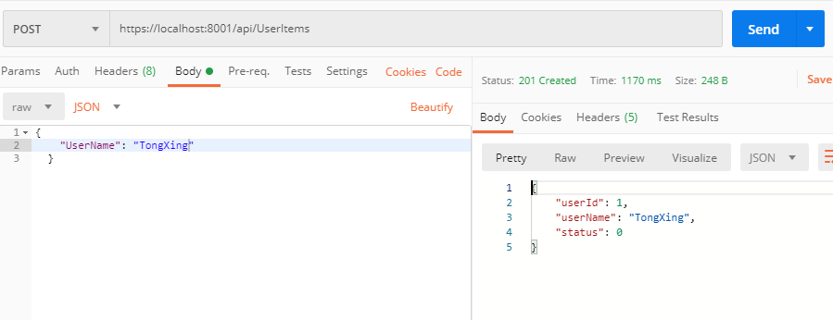
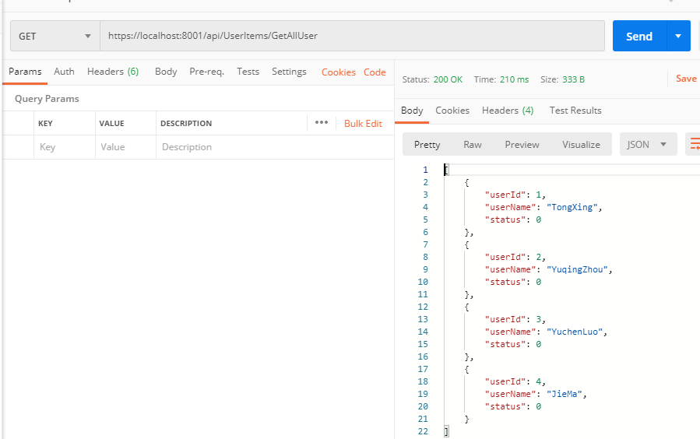
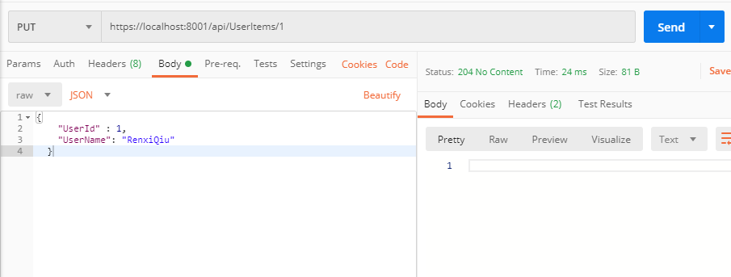
Testing Results
User microservice：

Slide 18
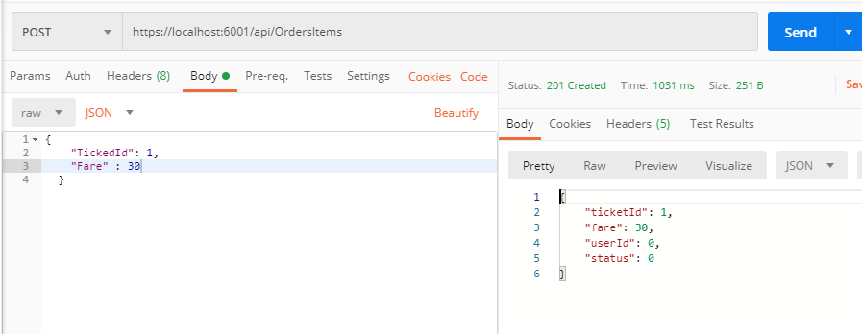
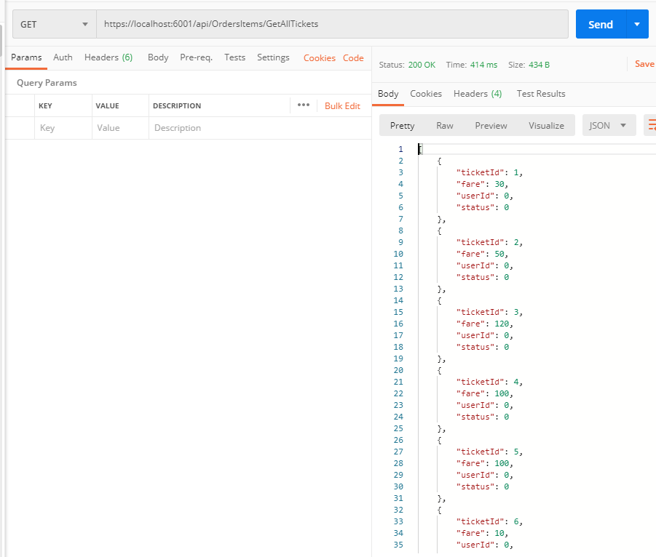
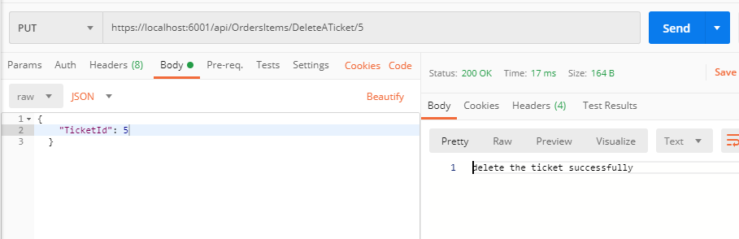
Testing Results
Ticket order microservice:

Slide 19
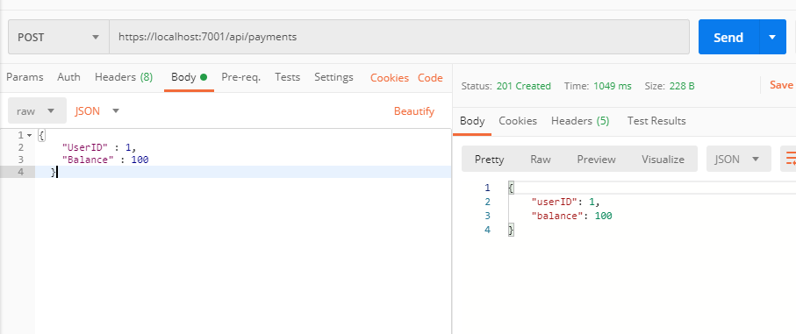
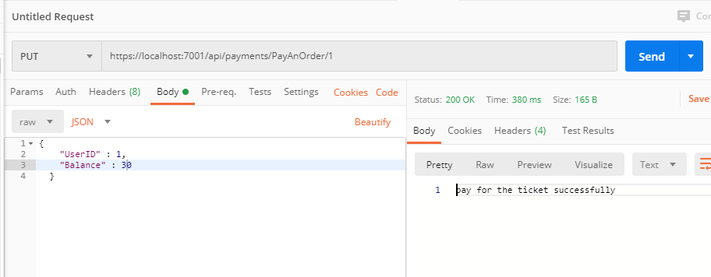
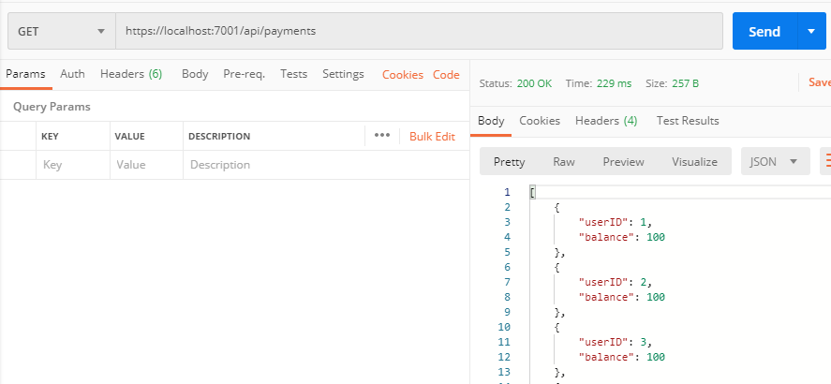
Testing Results
Payment microservice:

Slide 20
Thank you!

